Slide 1
Exception Handling
Exception handling is one of the most important feature of javaprogramming that allows us to handle the runtime errors caused by exceptions.
It is a mechanism to handle runtime errors such as ClassNotFoundException, IOException, SQLException, RemoteException, etc.
What is an Exception?
An Exception is an unwanted event that interrupts the normal flow of the program and terminates program abruptly.
Why an exception occurs?
There can be several reasons that can cause a program to throw exception.
For Example: Opening a non-existing file in your program, Network connection problem, bad input data provided by user etc.
Advantages :
It ensures, the flow of the program doesn’t break when an exception occurs.
By handling, make sure that all the statements execute and the flow of program doesn’t break.

Slide 2
Exception Handling
Error Vs Exception
Error: indicates serious problem that a reasonable application should not try to catch.
Exception: indicates conditions that a reasonable application might try to catch.
Types of Exception
There are mainy 2 types of Exceptions.
But, as per Oracle, they are :
Checked Exception
Unchecked Exception
Error (Unchecked Exception)

Slide 3
Types of Exception
Checked Exceptions :
All exceptions other than Runtime Exceptions are known as Checked exceptions as the compiler checks them during compilation to see whether the programmer has handled them or not.
If these exceptions are not handled/declared in the program, you will get compilation error.
Example : SQLException, IOException, ClassNotFoundException etc.
Un-Checked Exceptions :
Runtime Exceptions are also known as Unchecked Exceptions.
These exceptions are not checked at compile-time so compiler does not check whether the programmer has handled them or not but it’s the responsibility of the programmer to handle these exceptions and provide a safe exit.
Example : ArithmeticException, NullPointerException, ArrayIndexOutOfBoundsException etc.
Error : It is irrecoverable
Example : OutOfMemoryError, VirtualMachineError, AssertionError etc.

Slide 4
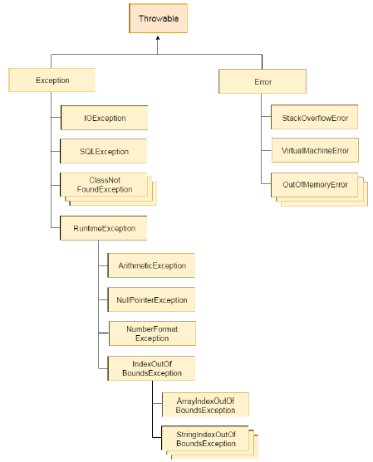
Hierarchy of Java Exception classes
The java.lang.Throwable class is the root class of Java Exception hierarchy which is inherited by two subclasses: Exception and Error.

Slide 5
Some Common Exceptions
Common scenarios where exceptions may occur :
1. int a=50/0; //ArithmeticException
2. String s=null;
System.out.println(s.length()); //NullPointerException
3. String s="abc";
i=Integer.parseInt(s); //NumberFormatException
4. int a[]=new int[5];
a[10]=50; //ArrayIndexOutOfBoundsException

Slide 6
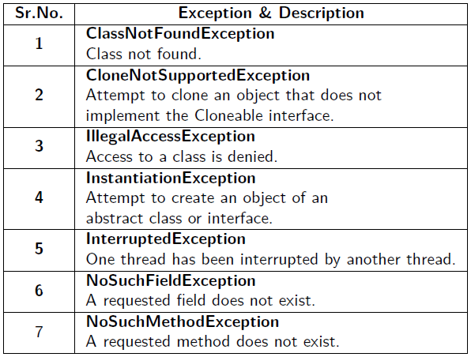
Checked Exceptions
Java defines several exception classes inside the standard package java.lang.

Slide 7
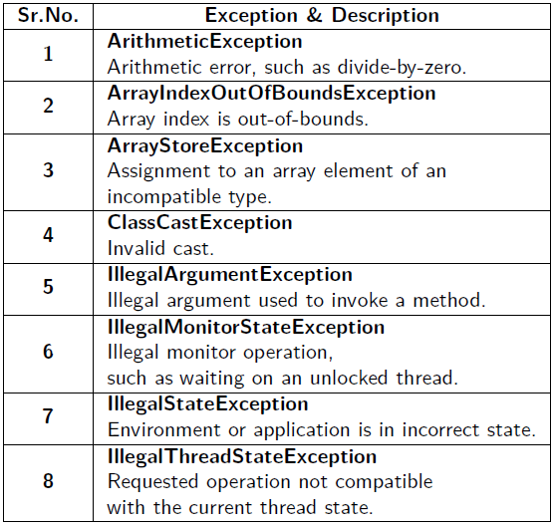
Unchecked Exceptions

Slide 8
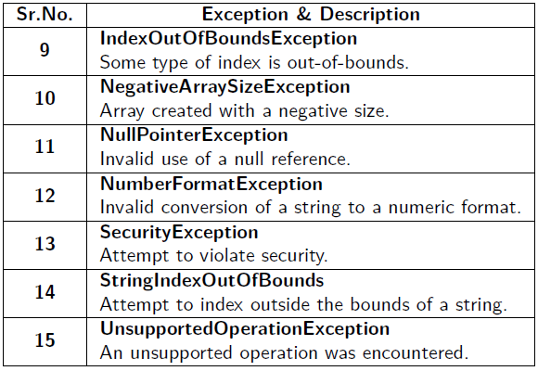
Unchecked Exceptions

Slide 9
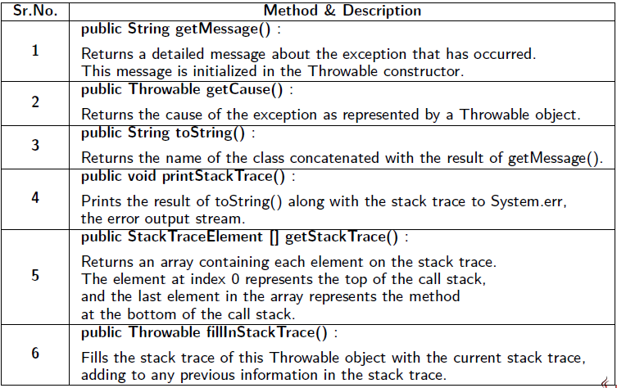
Java Exception Methods

Slide 10
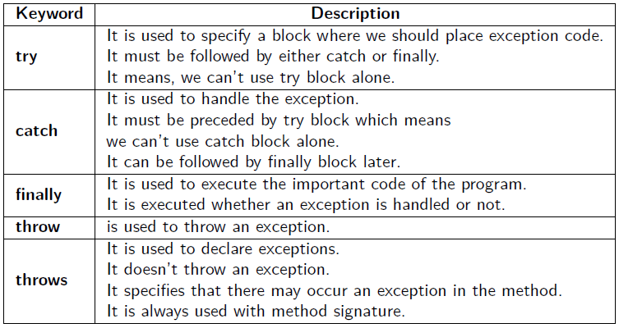
Java Exception Keywords

Slide 11
try and catch Block
Syntax :
// The try and catch keywords come in pairs:
try {
......
// Block of code to try
......
}
catch(Exception e) {
......
// Block of code to handle exceptions
......
}

Slide 12
Example-1 : Exception Handling
Without Exception Handling:
public class Exception1 {
public static void main(String[ ] args) {
int[] myNum= {1, 2, 3};
System.out.println(myNum[10]); // error!
}
}
// Exception in thread "main" java.lang.ArrayIndexOutOfBoundsException: 10
at Main.main(Main.java:4)

Slide 13
Example-1 : Exception Handling
With Exception Handling:
public class Exception1 {
public static void main(String[ ] args) {
try {
int[] myNum= {1, 2, 3};
System.out.println(myNum[1]);
}
catch (Exception e) {
System.out.println("Something went wrong.");
}}}
Something went wrong.

Slide 14
Example-1 : Exception Handling
With Exception Handling:
public class Exception1 {
public static void main(String[ ] args) {
try {
int[] myNum= {1, 2, 3};
System.out.println(myNum[10]);
}
catch (Exception e) {
System.out.println("Something went wrong.");
}}}
Something went wrong.

Slide 15
Example 2: Exception Handling
Without Exception Handling
public class Testtrycatch1 {
public static void main(String args[]){
int data=50/0;
System.out.println("rest of the code...");
}
}
Output: Exception in thread main java.lang.ArithmeticException:/ by zero
(rest of the code is not executed)

Slide 16
Example 2: Exception Handling
With Exception Handling
public class Testtrycatch1{
public static void main(String args[]){
try{
int data=50/0;
}catch(ArithmeticException e){System.out.println(e);}
System.out.println("rest of the code...");
}
}
Output: Exception in thread main java.lang.ArithmeticException:/ by zero
rest of the code...

Slide 17
Example 3 : Multiple Catch Blocks
public class MultipleCatchBlock{
public static void main(String args[]){
try{
int a[]=new int[5];
a[5]=30/0;
}
catch(Exception e){
System.out.println("Default Exception");
}
catch(ArithmeticException e){
System.out.println("Arithmetic Exception Caught");
}
catch(ArrayIndexOutOfBoundsException e) {
System.out.println("ArrayIndexOutOfBound Exception");
}
System.out.println("Rest of the code...");
} }
Output: Compilation Error

Slide 18
Example 3 : Multiple Catch Blocks (Right Way)
public class MultipleCatchBlock{
public static void main(String args[]){
try{
int a[]=new int[5];
a[5]=30/0;
}
catch(ArithmeticException e){
System.out.println("Arithmetic Exception Caught");
}
catch(ArrayIndexOutOfBoundsException e) {
System.out.println("ArrayIndexOutOfBound Exception");
}
catch(Exception e){
System.out.println("Default Exception");
}
System.out.println("Rest of the code...");
} }
Output: Arithmetic Exception Caught
Rest of the code...

Slide 19
Nested Try Block
Block within another Block is called as Nested Block.
The try block within a try block is known as Nested try block.
Why use nested try block. . . ?
Sometimes a situation may arise where a part of a block may cause one error and the entire block itself may cause another error. In such cases, exception handlers have to be nested.
try
{
statement 1;
statement 2;
try {
statement 1;
statement 2;
}
catch(Exception e) { }
}
catch(Exception e) { }
...

Slide 20
Nested Try Block Example
class NestedException{
public static void main(String args[]){
try{
try{
System.out.println("going to divide");
int b =39/0;
}
catch(ArithmeticException e){System.out.println(e);}
try{
int a[]=new int[5];
a[5]=4;
}
catch(ArrayIndexOutOfBoundsException e){ System.out.println(e); }
System.out.println("other statement");
}
catch(Exception e){System.out.println("handeled");}
System.out.println("normal flow..");
}
}

Slide 21
Java Finally Block
It is used to execute vital code such as closing connection, stream etc.
It is always executed whether exception is handled or not.
It must be followed by try or catch block.
Why Use Java finally?
It is used to put "clean-up“ code such as closing a file, closing connection etc.

Slide 22
Example Without & With finally block
Without finally
class withoutfinally1{
public static void main(String args[]){
try{
int a=args.length;
int x=5/a;
}catch (NumberFormatException e){}
System.out.println("Statement is placed without finally block");
}
}
With finally
class finally1 {
public static void main(String args[]) {
try { int a=args.length; int x=5/a; }
catch(ArithmeticException e){ System.out.println(e); }
finally{ System.out.println("Finally statement"); }
}
}

Slide 23
Java Throw Keyword
It is used to explicitly throw an exception either checked or unchecked.
It is mainly used to throw custom exception.
Syntax : throw exception;
Example : throw new IOException("sorry device error”);
Consider the below program :
public class TestThrow1{
static void validate(int age){
if(age<18)
throw new ArithmeticException("not valid");
else
System.out.println("welcome to vote");
}
public static void main(String args[]){
validate(13);
System.out.println("rest of the code...");
}}
Output:
Exception in thread main java.lang.ArithmeticException:not valid

Slide 24
Java Throws Keyword
It is used to declare an exception.
It gives an information to the programmer that there may occur an exception so it is better for the programmer to provide the exception handling code so that normal flow can be maintained.
Exception Handling is mainly used to handle the checked exceptions.
If there occurs any unchecked exception such as NullPointerException, it is programmers fault that he is not performing check up before the code being used.
Syntax :
return_type method_name() throws exception_class_name {
......
//method code
......
}

Slide 25
Java Throws Keyword
Which exception should be declared?
Ans : checked exception only,
unchecked Exception: under your control so correct your code.
error: beyond our control
Advantage of Java throws keyword
It provides information to the caller of the method about the exception.

Slide 26
Java Throw Keyword
class Testthrows1{
void m() throws IOException{
throw new IOException("device error"); //checked }
void n() throws IOException{ m(); }
void p(){
try{
n(); }
catch(Exception e){
System.out.println("exception handled");
}
}
public static void main(String args[]){
Testthrows1 obj=new Testthrows1();
obj.p();
System.out.println("normal flow...");
}
}
Output:
exception handled
normal flow...

Slide 27
Realtime scenario for java exception handling
import java.io.File;
import java.io.FileReader;
import java.io.IOException;
public class ReadData_Demo {
public static void main(String args[]) {
FileReader fr = null;
try{
File file = new File("file.txt");
fr = new FileReader(file);
char [] a = new char[50];
fr.read(a); // reads the content to the array
// prints the characters one by one
for(char c : a) System.out.print(c);
}
catch (IOException e) { e.printStackTrace(); }
finally {
try { fr.close(); }
catch (IOException ex) { ex.printStackTrace(); }
}
}
}

Slide 28
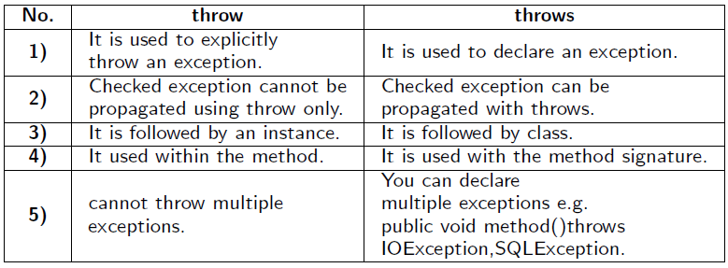
Comparison of throw and throws

Slide 29
User Defined Exceptions
We can define our own set of conditions or rules and throw an exception explicitly using throw keyword.
For example, we can throw ArithmeticException when we divide number by 0, or any other numbers, what we need to do is just set the condition and throw any exception using throw keyword.
Syntax:
throw new exception_class("error message");
Example :
throw new ArithmeticException("Dividing by Zero");
Points to Remember :
All exceptions must be a child of Throwable.
If you want to write a checked exception that is automatically enforced by the Handle or Declare Rule, you need to extend the Exception class.
If you want to write a runtime exception, you need to extend the RuntimeException class.

Slide 30
Example-1 : User-Defined Exception
class InvalidAgeException extends Exception{
InvalidAgeException(String s){ super(s); }
}
class TestCustomException1{
static void validate(int age) throws InvalidAgeException{
if(age<18)
throw new InvalidAgeException("not valid");
else System.out.println("welcome to vote");
}
public static void main(String args[]){
try{
validate(13);
}
catch(Exception m){
System.out.println("Exception occured: "+m);
}
System.out.println("rest of the code...");
}}
Output:
Exception occured: InvalidAgeException:not valid
rest of the code...

Slide 31
Example-2 : User-Defined Exception
public class ThrowExampleDemo{
static void checkEligibilty(int grescore){
if(grescore<315) {
throw new ArithmeticException("Not eligible ");
}
else System.out.println("Student Entry is Valid!!");
}
public static void main(String args[]){
System.out.println("Welcome to the Admission process!!");
checkEligibilty(300);
System.out.println("Have a nice day..");
}
}
Output:
Not eligible

Slide 32
Example-3 : User-Defined Exception
// File Name InsufficientFundsException.java
import java.io.*;
public class InsufficientFundsException extends Exception {
private double amount;
public InsufficientFundsException(double amount) {
this.amount = amount;
}
public double getAmount() { return amount; }
}
// File Name CheckingAccount.java
import java.io.*;
public class CheckingAccount {
private double balance;
private int number;
public CheckingAccount(int number) { this.number = number; }
public void deposit(double amount) { balance += amount; }

Slide 33
Example-3 : User-Defined Exception
public void withdraw(double amount) throws InsufficientFundsException {
if(amount <= balance) balance -= amount;
else {
double needs = amount - balance;
throw new InsufficientFundsException(needs);
}
}
public double getBalance() { return balance; }
public int getNumber() { return number; }
}

Slide 34
Example-3 : User-Defined Exception
// File Name BankDemo.java
public class BankDemo {
public static void main(String [] args) {
CheckingAccount c = new CheckingAccount(101);
System.out.println("Depositing $500...");
c.deposit(500.00);
try {
System.out.println("\nWithdrawing $100...");
c.withdraw(100.00);
System.out.println("\nWithdrawing $600...");
c.withdraw(600.00);
}
catch (InsufficientFundsException e) {
System.out.println("Sorry, but you are short " + e.getAmount());
e.printStackTrace();
}
}
}
Output:
Depositing $500...
Withdrawing $100...
Withdrawing $600...
Sorry, but you are short $200.0
InsufficientFundsException at CheckingAccount.withdraw(CheckingAccount.java:25)
at BankDemo.main(BankDemo.java:13)

Slide 35
Multithreading in Java
Multithreading in Java is a process of executing multiple threads simultaneously.
A thread is a lightweight sub-process, the smallest unit of processing.
Multiprocessing and multithreading, both are used to achieve multitasking.
Why Multithreading, not Multiprocessing?
Threads use a shared memory area, They don’t allocate separate memory area so saves memory.
Context-switching between the threads takes less time than process.
Java Multithreading is mostly used in games, animation, etc.
Advantages:
It doesn’t block the user, because threads are independent and you can perform multiple operations at the same time.
You can perform many operations together, so it saves time.
Threads are independent, so it doesn’t affect other threads if an exception occurs in a single thread.
Cost of thread intercommunication is relatively low that that of process intercommunication.
Threads allow different tasks to be performed concurrently.

Slide 36
Multitasking
Multitasking is a process of executing multiple tasks simultaneously. It is used to utilize the CPU efficiently.
Multitasking can be achieved in two ways:
Process-based Multitasking (Multiprocessing) :
Each process has an address in memory. In other words, each process allocates a separate memory area.
A process is heavyweight.
Cost of communication between the process is high.
Switching from one process to another requires some time for saving and loading registers, memory maps, updating lists, etc.
Thread-based Multitasking (Multithreading) :
Threads share the same address space.
A thread is lightweight.
Cost of communication between the thread is low.

Slide 37
What is Thread ?
It is a lightweight sub-process and the smallest unit of processing, has a separate path of execution.
Threads are independent. If there occurs exception in one thread, it doesn’t affect other threads.
It uses a shared memory area.

Slide 38
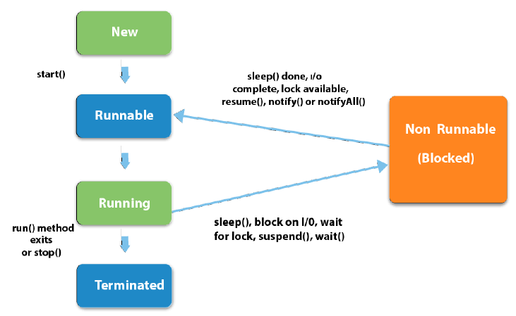
Thread Life Cycle (Thread States)

Slide 39
Thread States
A thread can be in one of the five states
New : The thread is in new state if you create an instance of Thread class but before the invocation of start() method.
Runnable : The thread is in runnable state after invocation of start() method, but the thread scheduler has not selected it to be the running thread.
Running : The thread is in running state if the thread scheduler has selected it.
Non-Runnable (Blocked) : This is the state when the thread is still alive, but is currently not eligible to run.
Terminated : A thread is in terminated or dead state when its run() method exits.

Slide 40
THANK YOU

